Slide 1
The Programme for International Student Assessment (PISA)
OECD

Slide 2
What PISA is.
What PISA assesses.
Method of assessment.
Participating countries.

Slide 3
What PISA seeks to accomplish How PISA works
OECD’s Programme for International Student Assessment (PISA)

Slide 4
In the dark… …all students, schools and education systems look the same…
But a little light….

Slide 5
In the dark… …all students, schools and education systems look the same…
But a little light….
…can show important differences….

Slide 6
(PISA) is an internationally standardised assessment that was jointly developed by participating countries and administered to15-year-olds in schools.

Slide 7
What PISA Assesses
PISA assesses how far students near the end of compulsory education have acquired some of the knowledge and skills that are essential for full participation in society.
In all cycles, the domains of reading, mathematical and scientific literacy are covered , but in terms of important knowledge and skills needed in adult life.

Slide 8
Method of Assessment
Pencil-and-paper tests are used, with assessments lasting a total of two hours for each student.
The items are organised in groups based on a passage setting out a real-life situation.
A total of about seven hours of test items is covered, with different students taking different combinations of test items.

Slide 9
Participating Countries
OECD’s Programme for International Student Assessment (PISA)

Slide 10
PISA 2000: 43 countries participated in the assessment.

Slide 11
PISA 2003: 41 countries participated in the assessment.

Slide 12
PISA 2006: 57 countries participated in the assessment.

Slide 13
PISA 2009

Slide 14
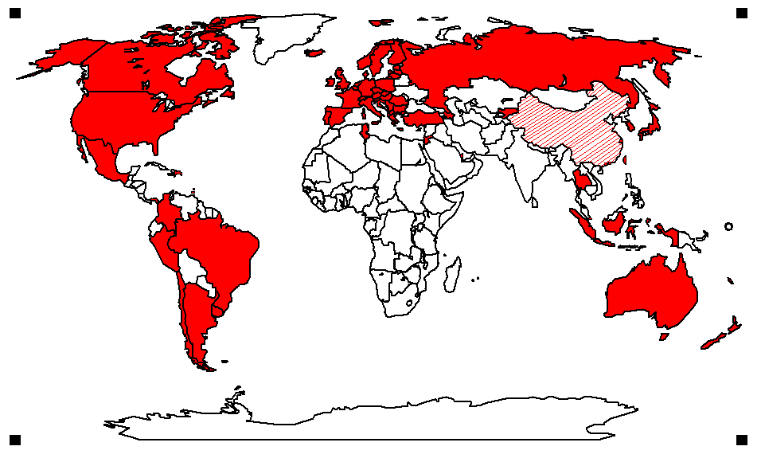
PISA countries in 2009

Slide 15
PISA 2009: 67 countries are participating in the assessment.

Slide 16
How PISA works
Who benefits from PISA and who pays !?

Slide 17
Enjoyment of science
OECD (2007), PISA 2006 – Science Competencies for Tomorrow’s World, Figure 3.10

Slide 18
Concern for environmental issues
OECD (2007), PISA 2006 – Science Competencies for Tomorrow’s World, Figure 3. 19

Slide 19
OECD (2007), PISA 2006 – Science Competencies for Tomorrow’s World, Figure 3.4

Slide 20
References:
www.oecd.org
www.pisa.oecd.org
email: pisa@oecd.org

Slide 21
Presented By
Loaloa Riad
Ingy Srour.

